Slide 1
ISE-529 Predictive Analytics
Module 4: Linear Model Diagnosis and Assessment
Primary text: ISLR, Chapter 3.3.3 and 5.1

Slide 2
Linear Regression Model Diagnosis
ISLR 3.3.3

Slide 3
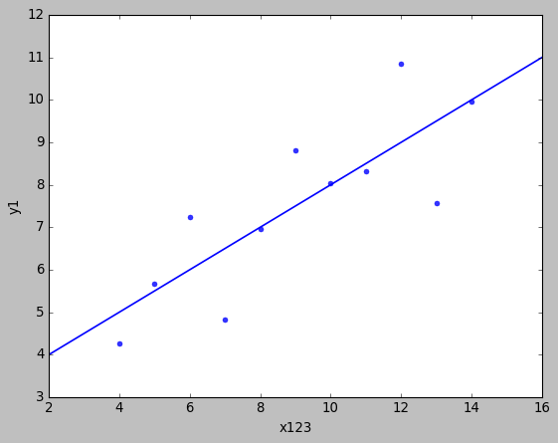
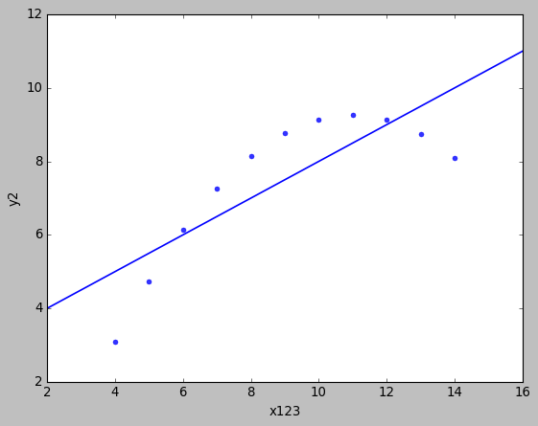
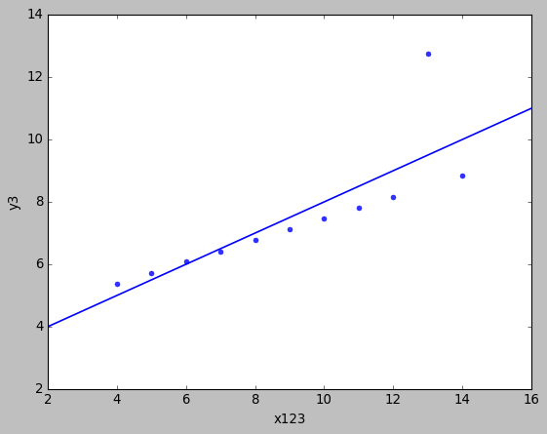
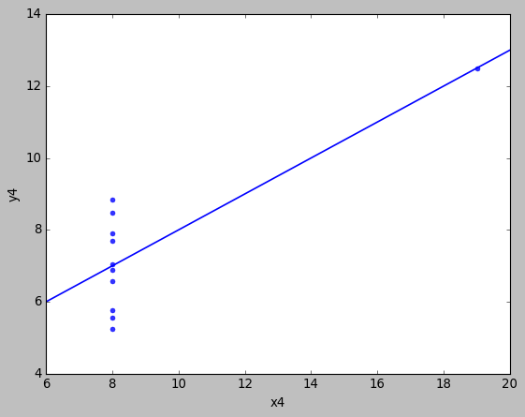

Model Diagnosis
Background – “Anscombe’s Quartet”
All four datasets have the same model when fit with a linear regression:
$$Y=3+0.5∗X$$
What’s going on with each of them?
*They also each have the same summary statistics (mean, standard deviation, correlation)

Slide 4

Linear Regression
Model Assumptions
By assuming a form of a parametric model, we are making a number of assumptions about the data:
$$Y=β_{0}+β_{1}X_{1}+β_{2}X_{2}+…+β_{p}X_{p}+ε ε∼iid N(0, σ^{2})$$
Linearity: The response variable increases linearly with increases in the predictor variables
Residuals: The residuals are independent, normally distributed, with zero mean and a constant variance (homoskedasticity)

Slide 5
Linear Regression Model Diagnosis
Overview
Whenever working with a parametric model, problems arise when the assumptions of the model are not met.
A significant part of linear regression model diagnosis is looking for violations of the four basic assumptions:
Linearity of the response-predictor relationship
Independence of the error terms (residuals)
Normal distribution of the error terms
Equal (constant) variance of the error terms (homoscedastic)
Can be remembered with the acronym LINE

Slide 6
Linear Regression Model Diagnosis
Residuals Analysis
A residuals plot provides much insight into issues with our model
Plot of fitted (predicted) values or independent variable (for SLR models) on X axis and residuals on the Y axis
From viewing this chart, we can get insight into three violations of the linear model assumptions:
Independence
Normality
Homoscedasticity
We can also readily identify outliers

Slide 7
Residuals Assessment Summary
Construct scatter plot of residuals against predicted values
Check for normality of residuals (graphical and statistical techniques)
Check for constant variance of residuals
Check the linearity assumption (looking for patterns in the residuals)
If applicable, assess the independence of the residuals over time
If this fails, a time series model may have to be considered

Slide 8
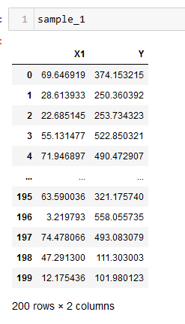
Residuals Analysis
Examples

Slide 9
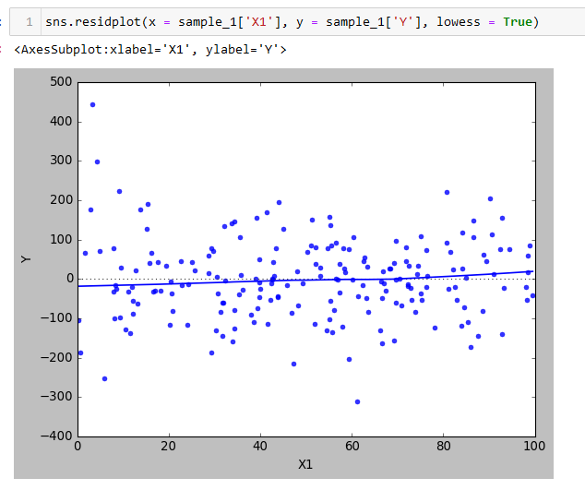
Residuals Analysis
Examples
Seaborn residplot function includes an optional parameter to include a smoothed average

Slide 10
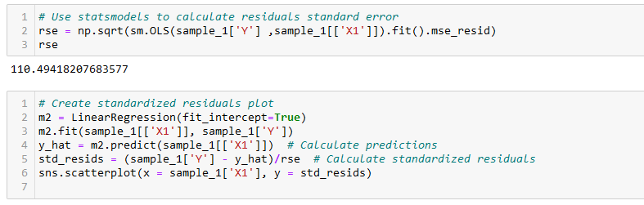
Residuals Analysis
Examples

Slide 11
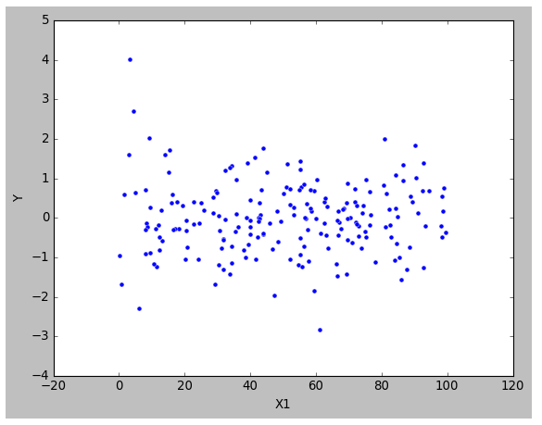
Residuals Analysis
Potential outlier, probably worth additional evaluation
Examples
Aprox 2/3 of points should be within one standard error
Aprox 95% of points should be within two standard errors
Generally, appears to satisfy LINE assumptions
No obvious patterns
Centered around 0 with roughly equal numbers of points above and below 0
Variance doesn’t obviously change over range of X1 (should check over range of predicted value of Y as well)

Slide 12
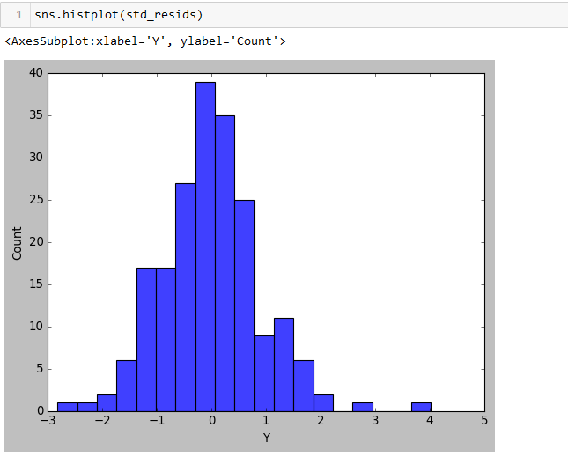
Residuals Analysis
Testing Residuals for Normality
Histogram of residuals is helpful to assess normality

Slide 13
Residuals Analysis
Testing Residuals for Normality
QQ plots are useful for visualizing whether a data series is normal
Can be used to test conformance with any probability distribution
Plots theoretical quantiles against the quantiles in the data series being assessed
Data perfectly conforming to the distribution will be on a diagonal line in a scatterplot

Slide 14
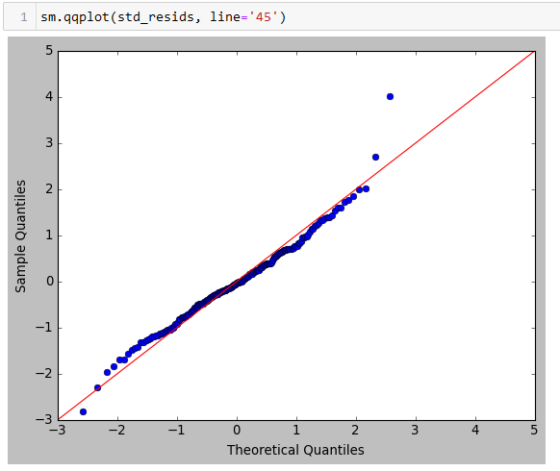
Residuals Analysis
QQ Plot
Z-Score of data (sorted)
Expected Z-Score of data element at that percentile (based on Normal distribution function)

Slide 15
Residuals Analysis
Statistical Tests for Normality
There are a number of statistical tests for normality:
Anderson-Darling test
Shapiro-Wilk test
Ryan-Joiner test
Kolmogorov-Smirnov test
They all provide a p-value with the null hypothesis that the residuals follow a normal distribution

Slide 16
Assessing the Model Assumptions
Residuals Analysis
Other tests for independence:
If the data was collected over time or space, create a scatterplot of the residuals with the time or space dimension on the x axis and look for any non-random patterns
Violation may suggest the need for a time series model
Create a series of residuals scatterplots with each predictor on the horizontal axis
Violation may suggest the need for transformation of predictor and/or response variable

Slide 17
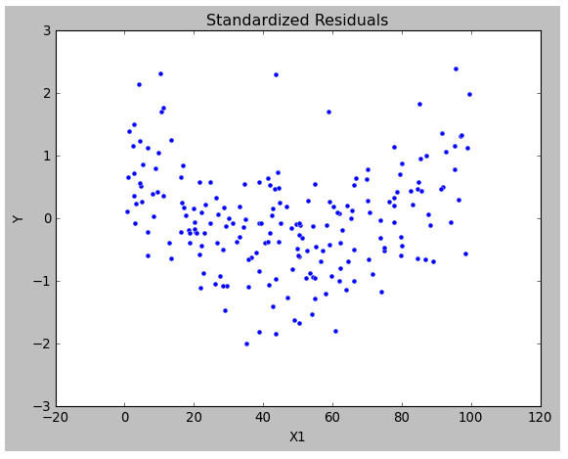
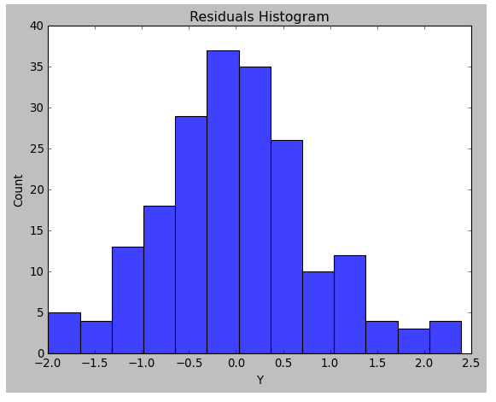
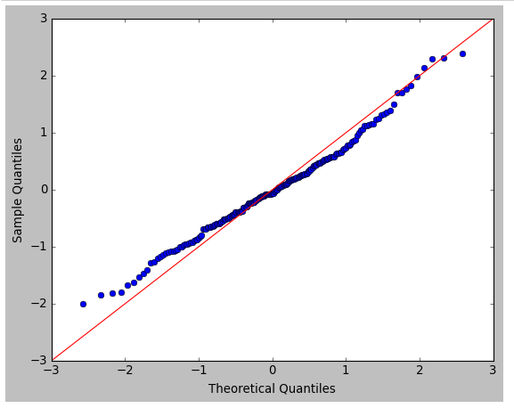
Residuals Analysis
Examples
What issue do you see here?

Slide 18
Residuals Analysis
Patterns/Non-Normality in Residuals
Model is not capturing some non-linear behavior
Trying a more complex (non-linear) model may improve it
Also, sometimes a variable transformation may help or there is a missing variable

Slide 19
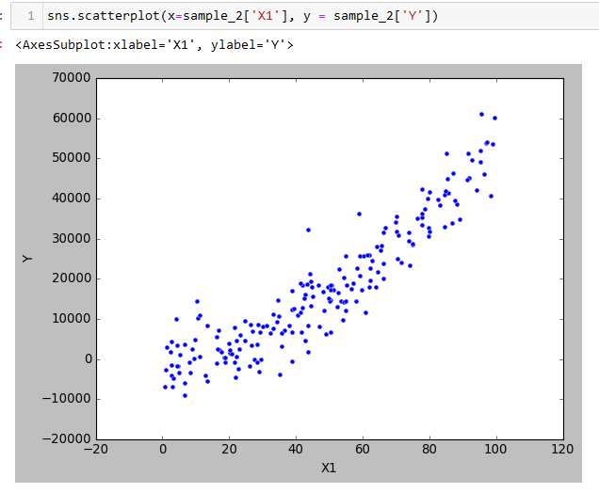
Residuals Analysis
Visualizing Predictor/Response Relationships

Slide 20
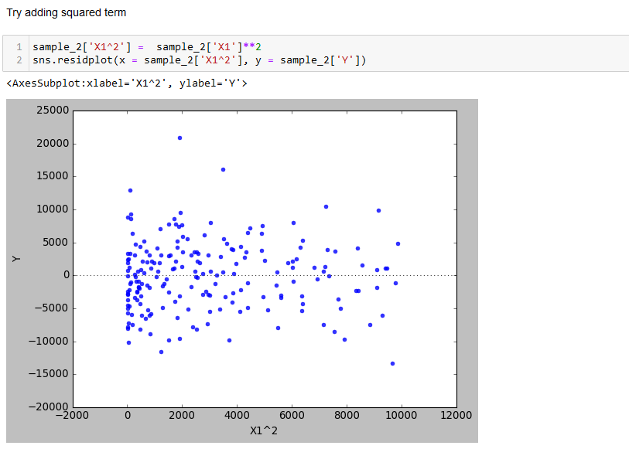
Residuals Analysis
Add Nonlinear Term

Slide 21
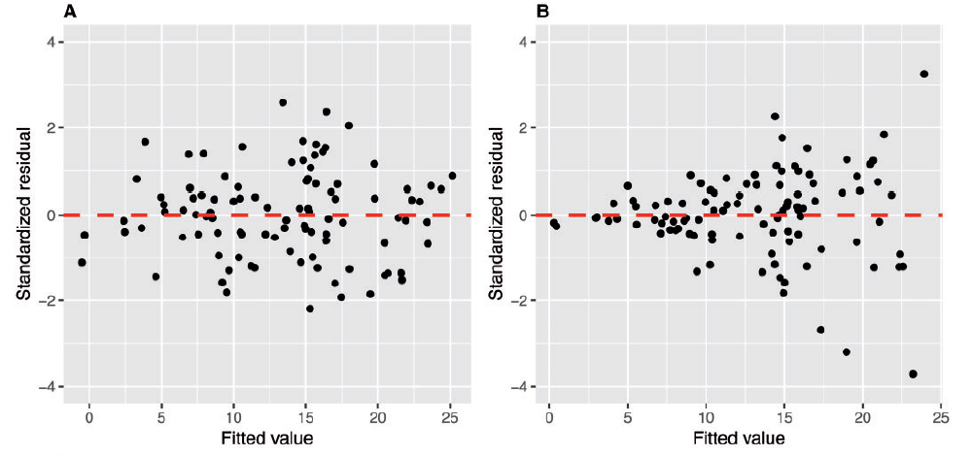
Residuals Analysis
Homoscedasticity

Slide 22
Residuals Analysis
Homoscedasticity
Not as serious as the independence assumptions
Coefficient estimations and predictions are reasonably robust to moderate heteroscedasticity
Primarily a problem for inference
Potential remedies
Explore potential model misspecifications (e.g., missing terms)
Apply a “variance stabilizing transformation” to the response variable
log, square root, reciprocal
Use an alternate model (“weighted least squares”, “generalized linear model”)

Slide 23
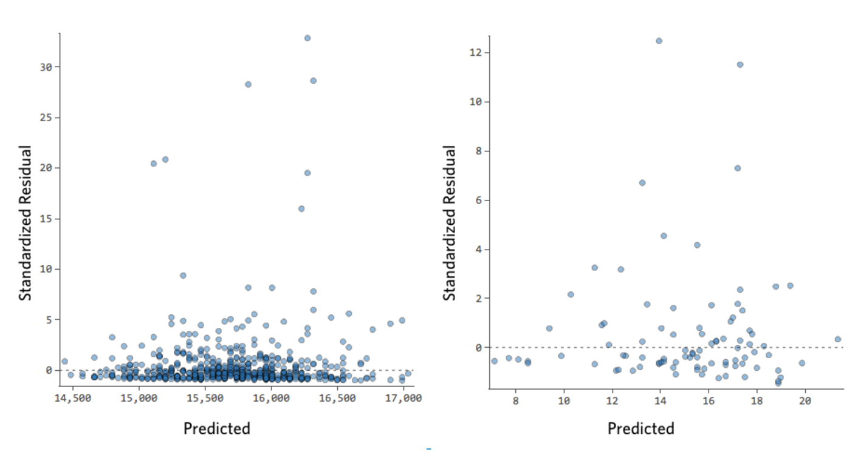
Residuals Analysis
Examples
Unbalanced Y axis
Model can be significantly improved
Usually by transforming a variable

Slide 24
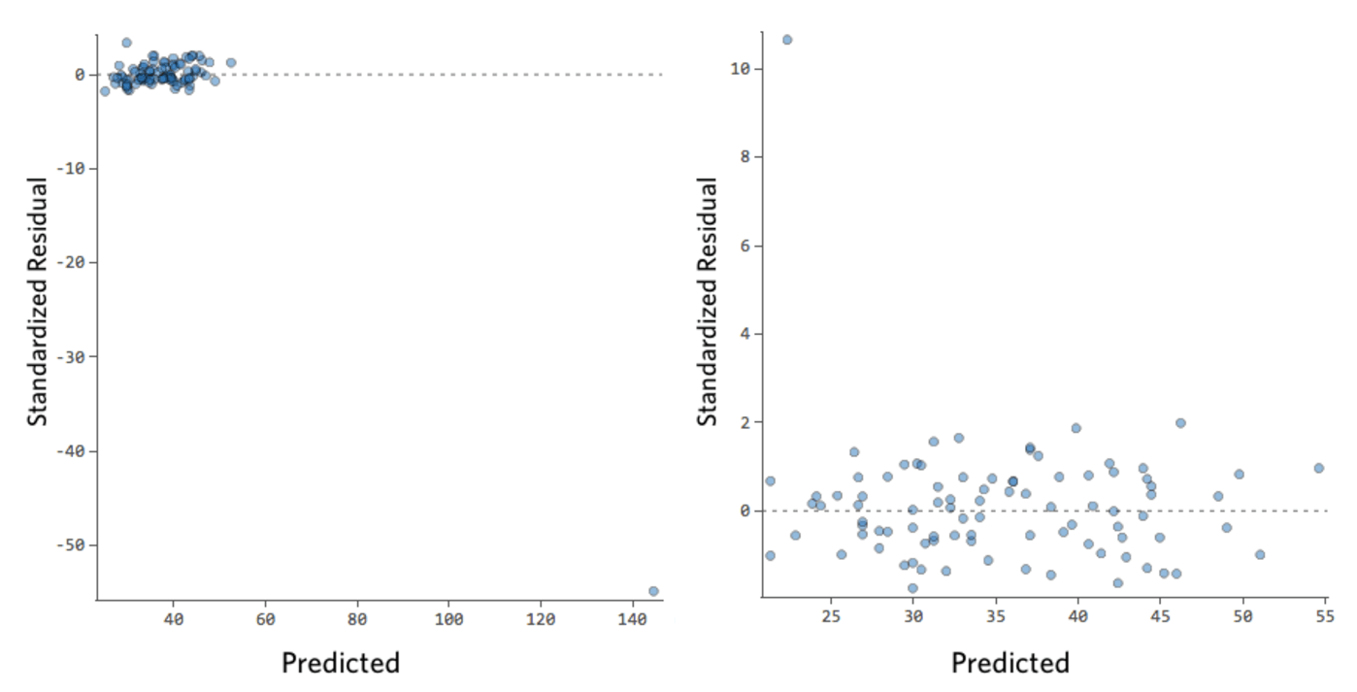
Residuals Analysis
Examples
Outliers
Identify and analyze the outlier for potential removal
Potential outliers may be a different “category”

Slide 25
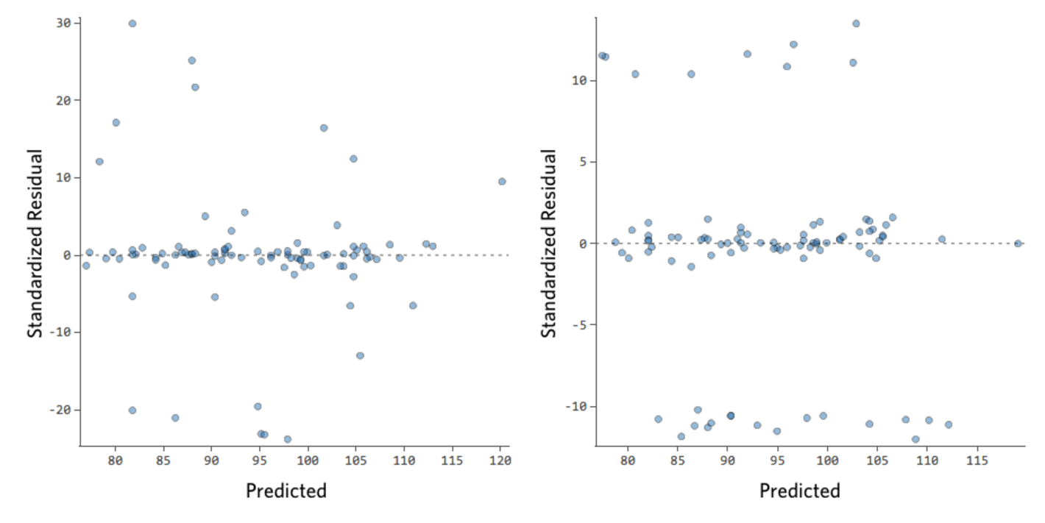
Residuals Analysis
Examples
Large Y-axis Datapoints
Probably has three different “categories” that need to be modeled separately (either with dummy variables or by separating datasets)

Slide 26
Linear Regression Model Diagnosis
Overview
Common sources of model problems
Unmodeled nonlinearities
Outliers/high-leverage observations
Collinearity of predictors
Heavily skewed predictors and/or response variables

Slide 27
Diagnosing Underperforming Models
Unmodeled Nonlinearity
Consider adding transforms of the predictors with apparent non-linear relationships to the output
Look for heavily skewed distributions of the predictors
Look at scatterplots between predictors and response
Log transformations are among the most common approach
Can be performed for both the predictor and the response

Slide 28
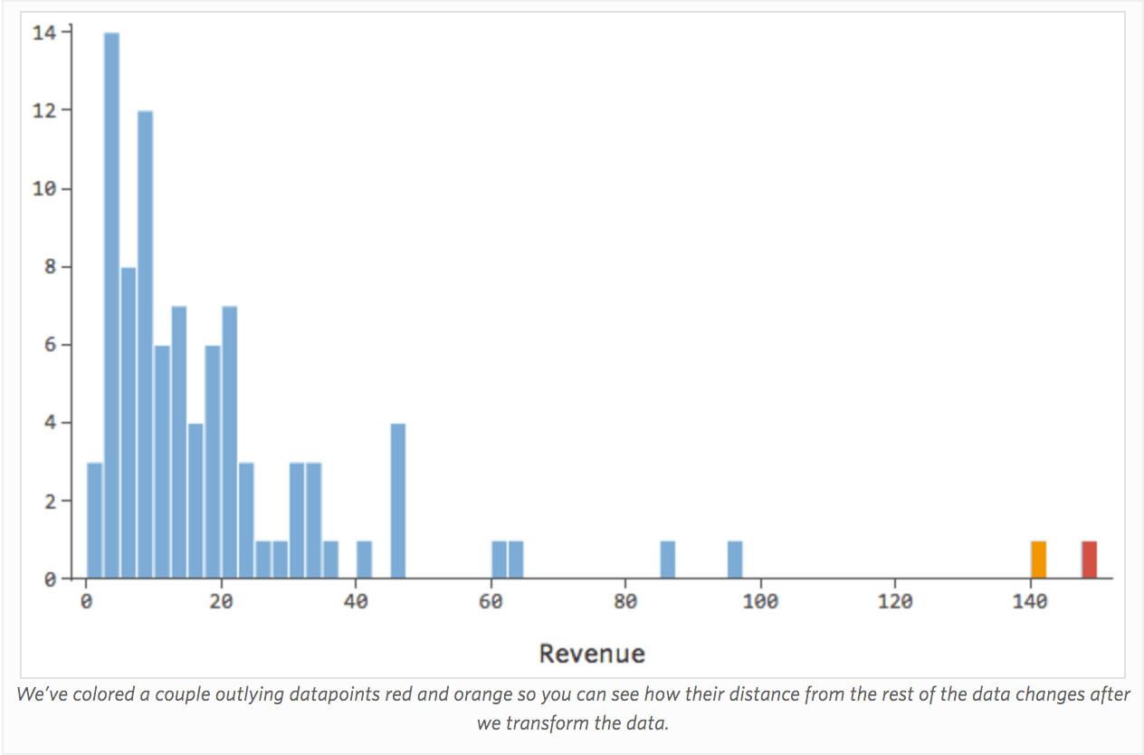
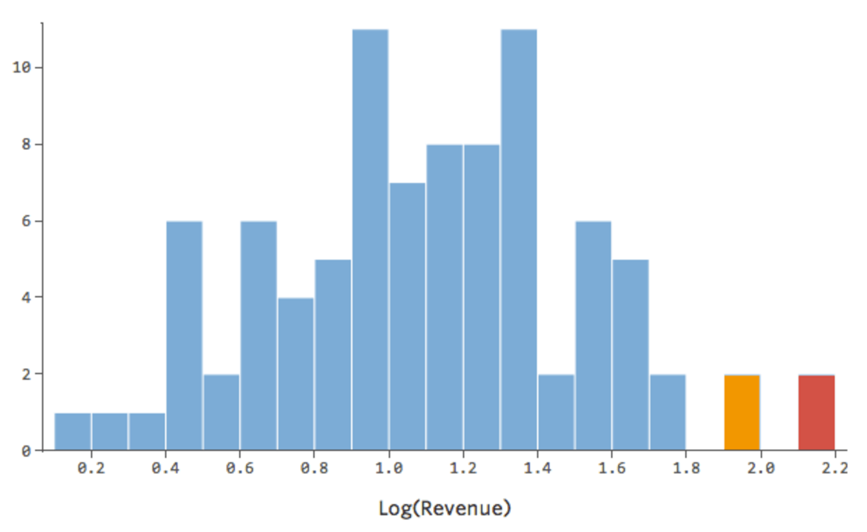
Variable Transformations
Log Transformation
Most common way to improve model performance
Usually with a log transformation

Slide 29
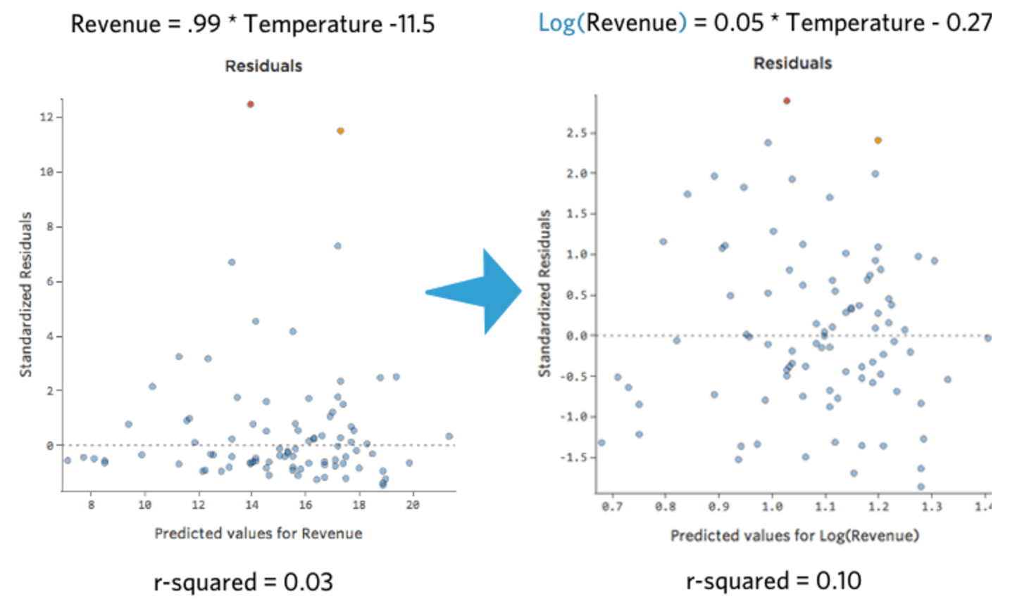
Variable Transformations
Log Transformation

Slide 30
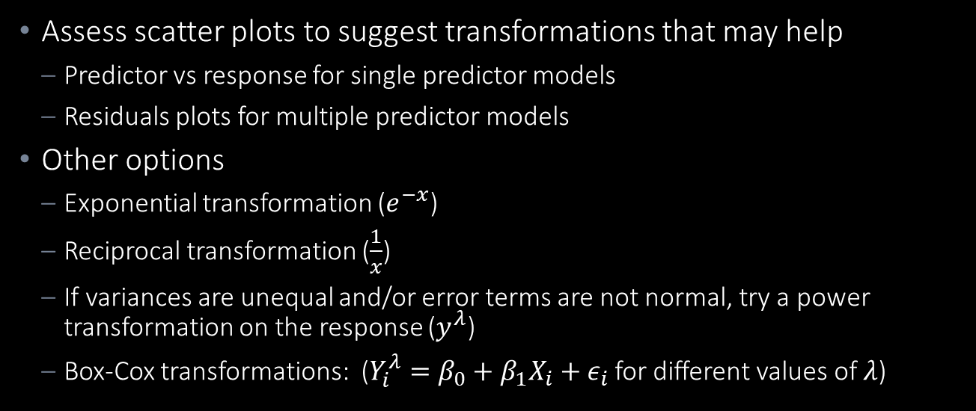
Variable Transformations
Other Transformations
Assess scatter plots to suggest transformations that may help
Predictor vs response for single predictor models
Residuals plots for multiple predictor models
Other options
Exponential transformation ($e^{−x}$)
Reciprocal transformation ($\frac{1}{x}$)
If variances are unequal and/or error terms are not normal, try a power transformation on the response ($y^{λ}$)
Box-Cox transformations: ($Y_{i}^{λ}=β_{0}+β_{1}X_{i}+ε_{i}$ for different values of $λ$)

Slide 31
Variable Transformations
Summary
It is NOT necessary to transform variables to get a normal distribution
Linear regression models do not have normality of variables as an assumption
The only test of normality required is on the residuals
Transforms make inference more difficult
However, highly skewed variables can cause the residuals to have a non-normal distribution
Recommended:
Check graphically the distribution of all variables
If some are slightly skewed, keep them as they are
Normalize highly skewed variables
After fitting the modl, make sure the residuals are normally distributed

Slide 32
Distortion by Outliers/High Leverage Observations

Slide 33
Diagnosing Underperforming Models
Investigate Outlying or Influential (“High Leverage”) Data Points
Outlier: data point whose response does not follow the general trend of the data
High Leverage: data point that significantly influences the model fit
If the data point is removed, does it significant change the model?
There are a number of statistical tests for outlier or high leverage data points, but we will limit ourselves to

Slide 34
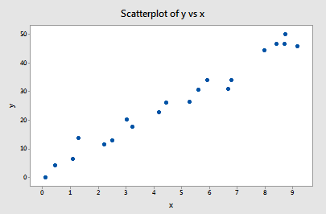
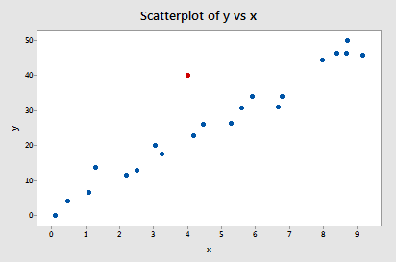
Diagnosing Underperforming Models
Investigate Outlying or Influential (“High Leverage”) Data Points
Is this an outlier?
Is this a high leverage point?

Slide 35
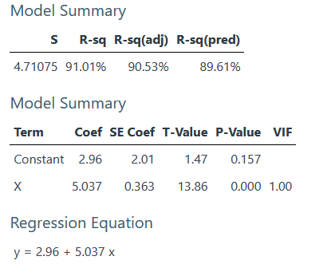
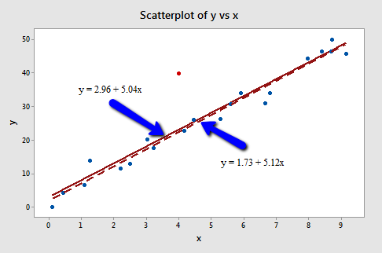
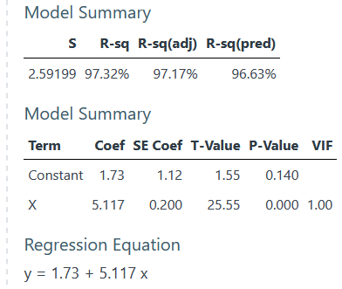
Diagnosing Underperforming Models
Investigate Outlying or Influential (“High Leverage”) Data Points
All data
Outlier removed

Slide 36
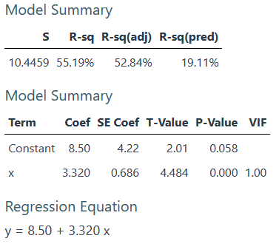
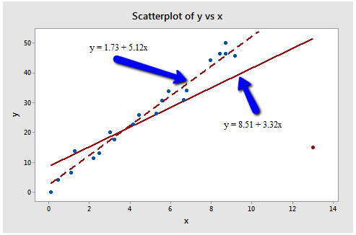
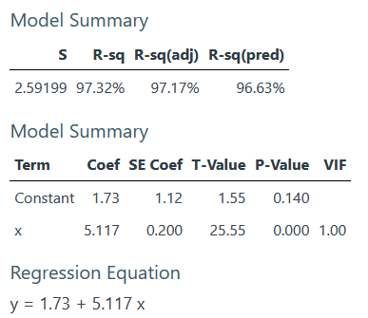
Diagnosing Underperforming Models
Investigate Outlying or Influential (“High Leverage”) Data Points
All data
Outlier removed

Slide 37
Diagnosing Underperforming Models
Investigate Outlying or Influential (“High Leverage”) Data Points
There are a number of statistical tests for high leverage observations, but we will limit ourselves to assessing the standardized residuals plot
Generally, any observation with a standardized residual above 5 is worth investigating

Slide 38
Diagnosing Underperforming Models
General Approach for Problematic Data Points
Check for obvious data errors
If data entry or collection error – delete it
If data point is not representative of intended study population – delete it
Consider possibility of misformulated regression model
Important predictors left out?
Interaction terms needed?
Nonlinearity that needs to be modeled?
NEVER delete data points just because they don’t fit your model!
You need a good, objective reason and it needs to be documented
One option is to analyze the data twice – with and without the data – and report results of both analyses

Slide 39
Multicollinearity

Slide 40

Diagnosing Underperforming Models
Multicollinearity
Two or more predictors are moderately or highly correlated causes several potential modeling problems:
Estimated regression coefficient of any one predictor depends on which other predictors are in the model (confounding)
Marginal contribution of any one predictor in reducing the error depends on which other predictors are already in the model
Hypothesis tests for $β_{k}=0$ may yield different conclusions depending on which predictors are in the model

Slide 41
Multicollinearity Problem
Background
Unfortunately, not all collinearity problems can be detected by inspection of the correlation matrix
It is possible for collinearity to exist between three or more variables even if no pair of variable has a particularly high correlation
We call this situation multicollinearity
A better way to assess multi-collinearity is to compute the variance inflation factor (VIF)

Slide 42



Variance Inflation Factor (VIF)
Measures the influence of a correlated predictor on the regression model coefficients
Ratio of the variance of ${\hat{β}}_{j}$ when fitting the full model divided by the variance of ${\hat{β}}_{j}$ if fitted on its own
$$VIF\left({\hat{β}}_{j}\right)=\frac{1}{1−{R^{2}}_{X_{j}|X_{−j}}}$$
where ${R^{2}}_{X_{j}|X_{−j}}$ is the $R^{2}$ of a regression model with $X_{j}$ as the response variable and predictors $X_{1}, …, X_{j−1},X_{j+1}, …, X_{p}$

Slide 43


Variance Inflation Factor (VIF)
$$VIF\left({\hat{β}}_{j}\right)=\frac{1}{1−{R^{2}}_{X_{j}|X_{−j}}}$$
If $X_{j}$ can be modelled well by the other variables combined, ${R^{2}}_{X_{j}|X_{−j}}$ will approach 1 and $VIF\left({\hat{β}}_{j}\right)$ will approach $∞$
If $X_{j}$ cannot be modelled well by the other variables combined, ${R^{2}}_{X_{j}|X_{−j}}$ will approach 0 and $VIF\left({\hat{β}}_{j}\right)$ will approach $1$

Slide 44
Variance Inflation Factor (VIF)
Interpretation
Typically, there is always a small level of collinearity among predictors
As a rule of thumb, a VIF that exceeds 5 or 10 causes problems
Approaches for dealing with collinearity:
Drop one of the problematic variables
Combine collinear predictors together into a single predictor
For instance, in the football player example we might combine weight and height into a “body size” predictor
Collect more data – often reduces the multicollinearity levels

Slide 45
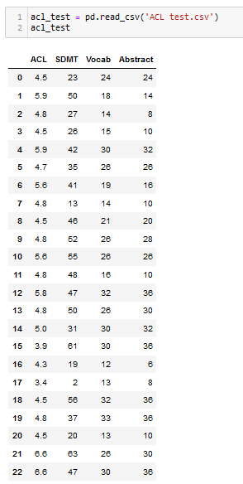
Variance Inflation Factor
Allen Cognitive Level Test Data

Slide 46
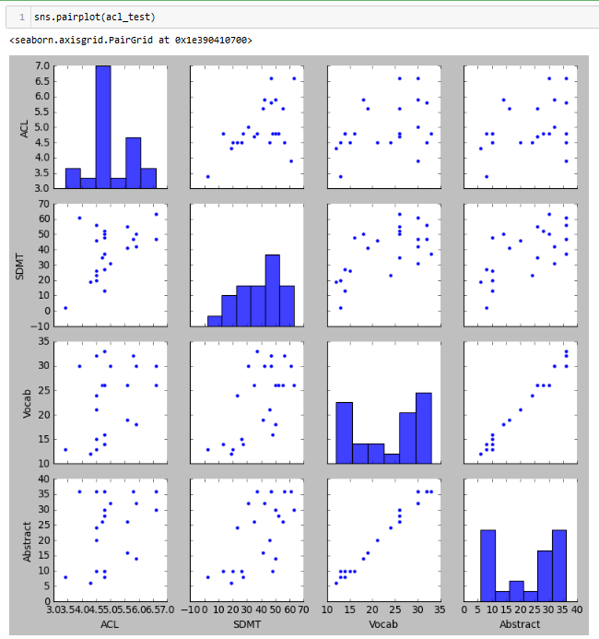
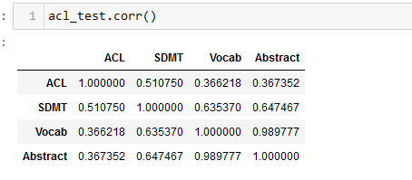
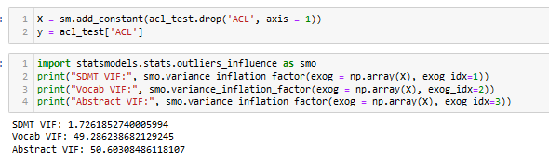
Diagnosing Underperforming Models
Multicollinearity
Three predictors
23 samples
Vocab and Abstract clearly highly correlated

Slide 47
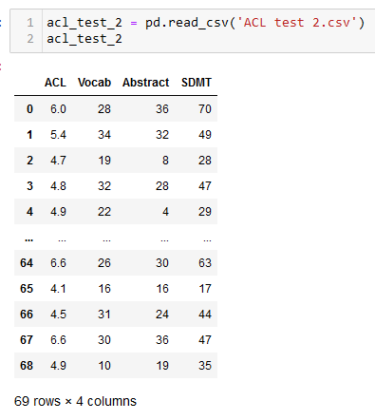
Variance Inflation Factor
Collecting Additional Data

Slide 48
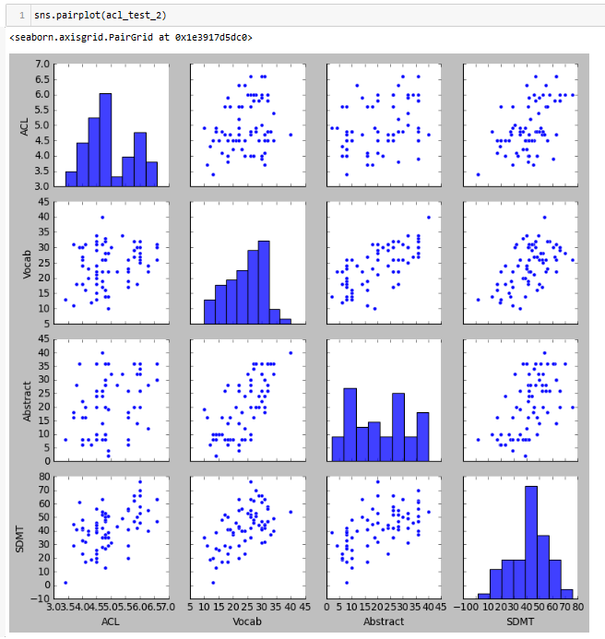
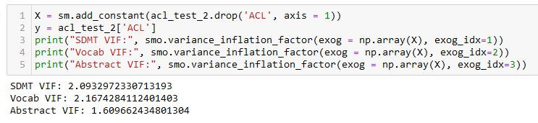
Diagnosing Underperforming Models
Multicollinearity
Three predictors
69 samples

Slide 49
Model Diagnosis Example
Predicting Fuel Efficiency from Engine Horsepower

Slide 50
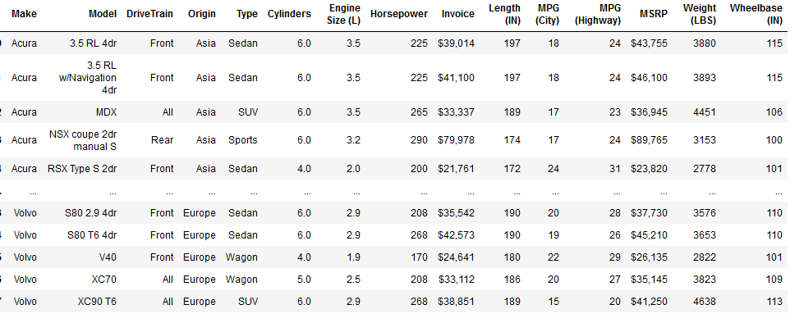
Model Diagnosis Example
Objective: predict MPG (City) from Horsepower

Slide 51
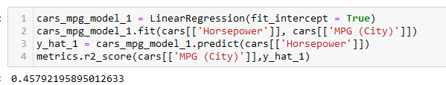
Model Diagnosis Example
Fit Simple Linear Regression Model to Data and Assess

Slide 52
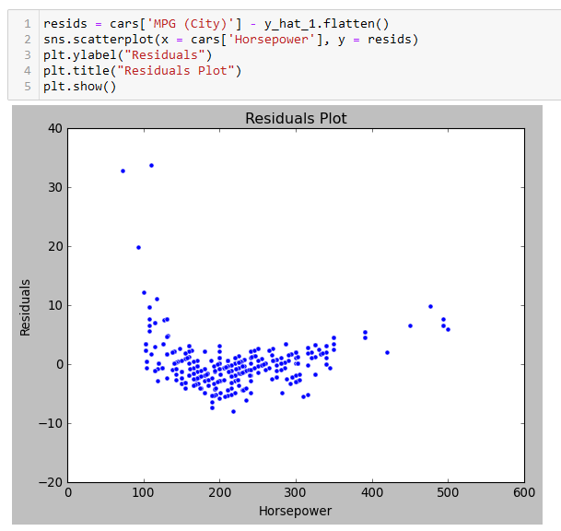
Model Diagnosis Example
Residuals Plot
Need to convert to a one-dimensional array

Slide 53
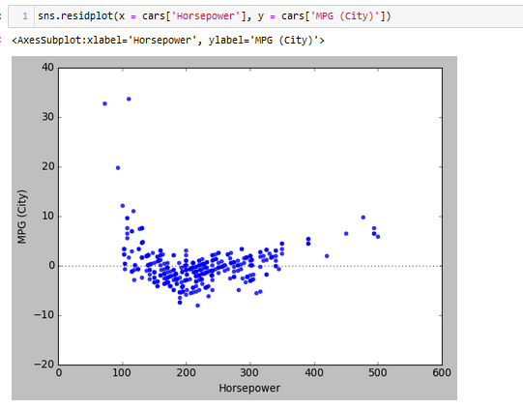
Model Diagnosis Example
Residuals Plot – Easier Way With Seaborn

Slide 54
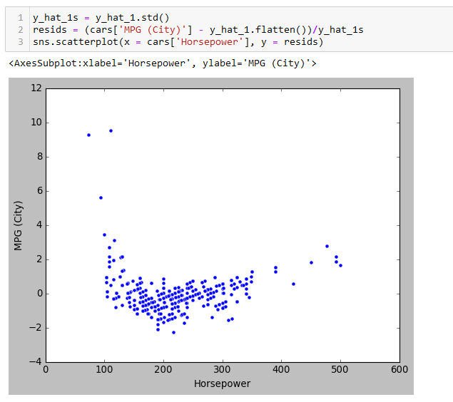
Model Diagnosis Example
Standardized Residuals Plot
What am I doing here?
Observations with large standardized residuals

Slide 55
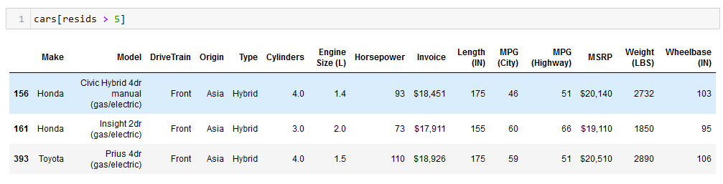
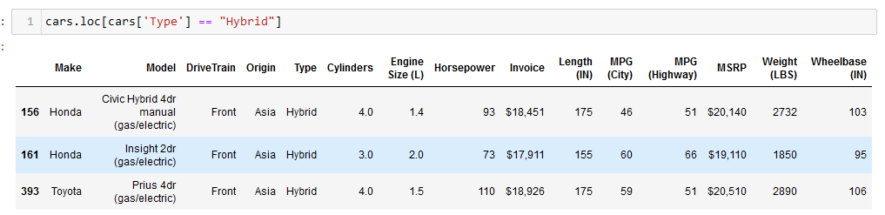
Model Diagnosis Example
Hybrids are a fundamentally different kind of engine that should probably be treated separately
Investigate Outliers

Slide 56
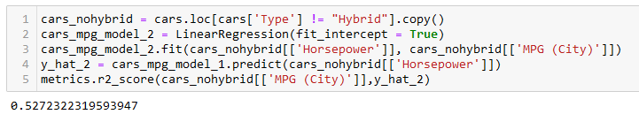
Model Diagnosis Example
Remove Outliers and Re-Run Regression

Slide 57
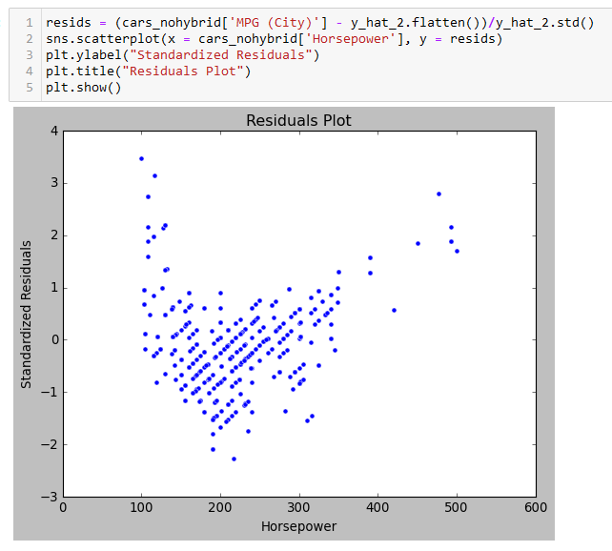
Model Diagnosis Example
Assess Standardized Residuals
Range of standardized residuals looks reasonable
What other issues to you see?

Slide 58
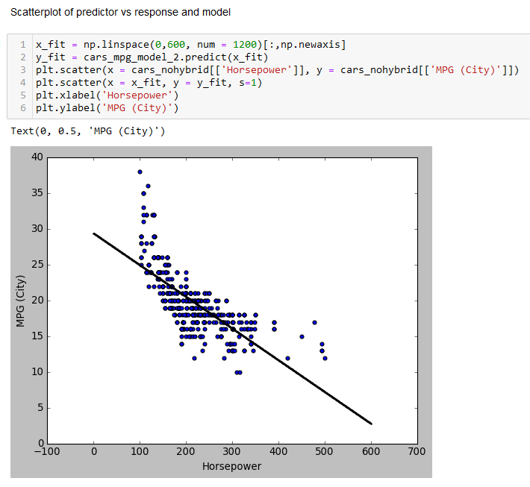
Model Diagnosis Example
Fit Model vs Data

Slide 59
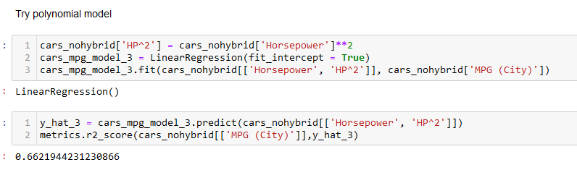
Model Diagnosis Example
Fitting Polynomial Regression

Slide 60
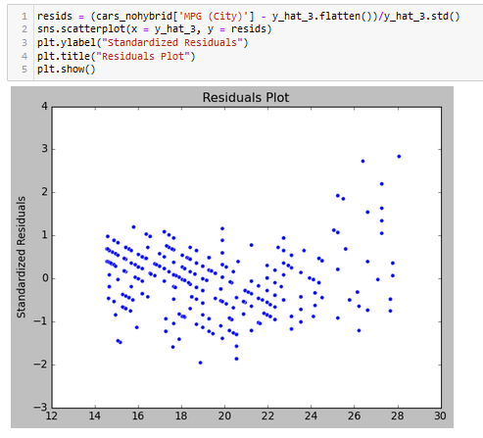
Model Diagnosis Example
Assess Standardized Residuals

Slide 61

Model Diagnosis Example
Fit Model vs Data

Slide 62





Model Diagnosis Example
Using SKLEARN’s PolynomialFeatures Library
Polynomial of order 3
$${HP}^{0}$$
$${HP}^{1}$$
$${HP}^{2}$$
$${HP}^{3}$$

Slide 63

Model Diagnosis Example
Third Order Polynomial Model

Slide 64

Model Diagnosis Example
Third Order Polynomial Model

Slide 65

Model Diagnosis Example
Fit Model vs Data

Slide 66

Model Diagnosis Example
Fourth Order Polynomial Model

Slide 67

Model Diagnosis Example
Fourth Order Polynomial Model

Slide 68

Model Diagnosis Example
Fit Model vs Data

Slide 69

Model Diagnosis Example
Fifth Order Polynomial Model

Slide 70

Model Diagnosis Example
Fifth Order Polynomial Model

Slide 71

Model Diagnosis Example
Fit Model vs Data

Slide 72

Model Diagnosis Example
Summarizing Polynomial Models
Model Order | Model $R^{2}$
1 | 0.5272
2 | 0.6622
3 | 0.7094
4 | 0.7145
5 | 0.7155
What’s going on here?

Slide 73

Model Diagnosis Example
Add Weight to Model

Slide 74

Model Diagnosis Example
Add Weight to Model

Slide 75

Model Diagnosis Example
Add Weight to Model

Slide 76

Model Diagnosis Example
Add Drivetrain to Model

Slide 77

Model Diagnosis Example
Add Drivetrain to Model

Slide 78

Model Diagnosis Example
Add Drivetrain to Model

Slide 79

Model Diagnosis Example
Add Drivetrain to Model

Slide 80

Model Diagnosis Example
Add Type to Model

Slide 81

Model Diagnosis Example
Add Type to Model

Slide 82

Model Diagnosis Example
Add Type to Model

Slide 83

Model Diagnosis Example
Add Type to Model

Slide 84



Model Diagnosis Example
Add Interaction Effect
Speculate that the effect horsepower has on MPG may differ based on the type of drive train (real, front, all-wheel drive)

Slide 85

Model Diagnosis Example
Add Interaction Effect

Slide 86

Model Diagnosis Example
Add Interaction Effect

Slide 87

Model Diagnosis Example
Add Interaction Effect

Slide 88

Model Diagnosis Example
Add Interaction Effect

Slide 89


Model Diagnosis Example
Consider Variable Transformations

Slide 90


Model Diagnosis Example
Consider Variable Transformations

Slide 91

Model Diagnosis Example
Consider Variable Transformations

Slide 92

Model Diagnosis Example
Transforming Response Variable

Slide 93

Model Diagnosis Example
Transforming Response Variable

Slide 94

Model Diagnosis Example
Transforming Response Variable

Slide 95
Summary
Recommended Model Diagnosis Process
Assess and address multi-collinearity
Deal with any variables with a correlation coefficient > 0.9 or a VIF greater than 5-10
Assess variable skew
Investigate transforming heavily skewed variables
Build initial model and investigate standardized residuals plot
Investigate and deal with outliers
Build updated model and assess standardized residuals plot for evidence of deviation from model assumptions (particularly independence)
Consider adding new predictors which are nonlinear functions of the original predictors
Consider adding interaction effects
Assess updated model for coefficient significance and investigate removing predictors to simplify model

Slide 96
Model Validation and Resampling Techniques
ISLR 5

Slide 97
Validation Objectives
Overview
When modeling for prediction:
Remember, our dataset is always viewed as a sample from a larger population
We are concerned with how will the model will perform with other, previously unseen data from that population

Slide 98
Validation Objectives
Overview
This module addresses two related topics:
How to ensure that a model doesn’t reflect attributes of our sample that don’t exist in the larger population (“overfitting”)
How to estimate what the performance of the model will be when applied to the larger population (estimating model mean and variance)

Slide 99

Validation Set Example
Polynomial Regression Models for Horsepower

Slide 100

Validation Set Example
Polynomial Regression Models for Horsepower

Slide 101

Validation Set Example
Polynomial Regression Models for Horsepower
How to determine the number of predictors to include in our model?
Clearly, we have reached a point of diminishing returns for improving the fit

Slide 102

Validation Set Example
Summarizing Polynomial Models
Model Order | Model $R^{2}$
1 | 0.5272
2 | 0.6622
3 | 0.7094
4 | 0.7145
5 | 0.7155
In linear models, model fit statistic calculated using the training data ($R^{2}$ in this example) will always improve (or at worse stay the same) when adding more predictors.

Slide 103

Validation Set Example
Polynomial Regression Models for Horsepower
One approach is to look at the p-values for the coefficients on the various predictors
Traditional analysis indicates that the powers greater than 2 are not significant (using an alpha of 0.05) and thus should not be included in the model
Alternate (and generally preferred) approach is to perform model validation with separate data

Slide 104
Validation Approaches
Validation Set
Simplest and most used approach
Randomly divide the available set of samples into two parts: a training set and a validation or hold-out set
Model is fit on the training set and tested on the validation set
Resulting validation-set error provides an estimate of the test error

Slide 105


Validation Set Example
Creating a Validation Set With SKLEAN test_train_split

Slide 106

Validation Set Example
Using the Validation Set
Fit the model with the training data
Calculate the fit statistic based on the test data
Use the fit model to perform predictions on the test data

Slide 107

Validation Set Example
Using the Validation Set
Which polynomial power should be included in the model?

Slide 108

Validation Set Example
Summarizing Polynomial Models
Model Order | Training Model $R^{2}$ | Test Model $R^{2}$
1 | 0.5272 | 0.4068
2 | 0.6622 | 0.4796
3 | 0.7094 | 0.6650
4 | 0.7145 | 0.6636
5 | 0.7155 | 0.5263
We select the model with the best test partition assessment statistic

Slide 109
Validation Set Approach Issues
Validation estimate of model fit varies based on the random selection of observations to include in the training and test sets (“model variance”)
Only a subset of the observations are included in the training set
Statistical methods tend to perform worse when trained on fewer observations

Slide 110

Randomness in Model Fit
Example – New test_train_split
Now, which polynomial power should be included in the model?

Slide 111

Randomness in Model Fit
ISLR Figure 5.2

Slide 112


Leave-One-Out Cross Validation (LOOCV)
A single observation is held out and the model is trained with the remaining $n−1$ observations
The squared error is calculated for the held out observation
This process is repeated $n$ times for each datapoint
The test MSE is then calculated as ${CV}_{n}=\frac{1}{n}\sum_{i=1}^{n}{{MSE}_{i}}$

Slide 113

k-Fold Cross-Validation
Downside of LOOCV is it requires fitting $n$ different models which can be prohibitively time consuming
A widely-used alternative is k-Fold Cross-Validation:
Randomly divide data into $K$ equal-sized parts.
For each value of $k=1,2,…K$, leave out part $k$, fit the model to the other $K−1$ parts (combined)
Obtain predictions for the left-out $k^{th}$ part and perform assessments
Combine the K different assessments

Slide 114

K-Fold Cross-Validation
Example

Slide 115
K-Fold Cross Validation
Mathematical Definition
Let the K parts be $C_{1},C_{2},…,C_{K}$ where $C_{k}$ denotes the indices of the observations in part $k$.
There are $n_{k}$ observations in part $k$
If $N$ is a multiple of $K$, then $n_{k}=n/K$
We estimate the test MSE using the K-Fold Cross Validation ${CV}_{(K)}$as follows:
$${CV}_{(K)}=\sum_{k=1}^{K}{\frac{n_{k}}{n}{MSE}_{k}}$$
where ${MSE}_{k}=\sum_{i∈C_{k}}{{(y_{i}−{\hat{y}}_{i})}^{2}/n_{k}}$ and ${\hat{y}}_{i}$ is the fit for observation $i$ obtained from the data with part $k$ removed

Slide 116

Leave-One Out Cross-Validation (LOOCV)
Special case of K-Fold validation when $k=n$ (and, thus, each partition has size 1) is referred to as Leave-One Out Cross-Validation (LOOCV)
k-Fold cross-validation with k = 10 has not much more variance than LOOCV

Slide 117

Bias-Variance Trade-Off for k-Fold Cross-Validation
As previously discussed, k-fold CV with $k<n$ can lead to overestimates (bias) of the test error rate since we are not using all of the data to train the model.
k-Fold CV uses more of the data than a simple training/test partition but still has leads to increased bias (due to using less data for training)
This bias is minimized when K=n (LOOCV) but this estimate has high variance when considered against the entire population (because all of the training samples are very similar)
K = 5 or 10 provides a good compromise for this bias-variance tradeoff

Slide 118
Cross-Validation Usage Pitfalls
Example Usage
Simple regression model with 5000 predictors (p = 5000) and 500 samples (n = 500):
Find the 100 predictors having the largest correlation with the class labels (outputs)
Develop a regression model using only these 100 predictors
Can we use cross-validation on this model??

Slide 119
Cross-Validation Usage Pitfalls
Example Usage
Usage of CV on this model would ignore the fact that the procedure has already “seen” the values of the response variables in the training data and made use of them
Selecting the 500 predictors to use is a form of training and must be included in the validation process
We must apply cross-validation to both steps in this process!

Slide 120

Wrong Way

Slide 121

Right Way

Slide 122
A Note on Using Both Test/Training Partitions and CV
Although CV techniques can be used as an alternative to a simple test/training partition approach, when used to fit the hyperparameters of a model (in this case, lambda), it is a best practice to use both.
Recall that it is frequently useful to partition a dataset into three partitions:
Training partition – used to fit the model
Validation partition – used to select the best model
Test partition – used to assess the performance of the final chosen model. USED ONLY ONCE at the end of the process for assessment only

Slide 123
A Note on Using Both Test/Training Partitions and CV
It is particularly important to have the third test partition when you are using the validation data to make decisions among many different models
When we are using cross-validation to select a hyperparameter (in this case, the order of the polynomial model), we are doing exactly that – looking at many different models and comparing them
Thus, it is a best practice to save a final “hold-out” set as depicted in the graphics on the next two pages

Slide 124

A Note on Using Both Test/Training Partitions and CV
Best Practice When Selecting Hyperparameters (Lambda)

Slide 125
Resampling Methods and Model Variance

Slide 126



Data and Sampling Distributions
Overview
Population mean: $μ$
Population std dev: $σ$
Sample mean: $\overline{x}$
Sample std dev: $s$

Slide 127
Estimators: Sample Statistics
We draw samples with the goal of measuring something or modeling something.
Sometimes in data science, our dataset contains the entire population of interest, but more often it is a “sample” of the larger population of interest
In order to assess the accuracy of our measurement or model, we are often interested in knowing what the distribution is of a sample statistic (like the sample mean).
Sample statistics are often used for constructing confidence intervals and performing hypothesis testing

Slide 128

Estimators: Sample Statistics
Model Parameters
Parameters of analytic models are generally sample statistics and thus have standard errors
Example: coefficients of a simple linear regression model
$${\hat{β}}_{1}=\frac{\sum_{i=1}^{n}{(x_{i}−\overline{x})(y_{i}−\overline{y})}}{\sum_{i=1}^{n}{{(x_{i}−\overline{x})}^{2}}}$$
$${\hat{β}}_{0}=\overline{y}−{\hat{β}}_{1}\overline{x}$$
We use the “hat” notation because these are estimates of their true values (“sample statistics”)

Slide 129
Resampling
Much of classical statistics is based on estimating the properties of sample statistics such as the sample mean and sample standard deviation (referred to as the “standard error”)
Computational statistics replaces the need for much of this theory with data-driven techniques referred to generally as “resampling”
Resampling techniques are used extensively in a variety of ways in predictive analytics

Slide 130

Bias and Variance
We are very interested in assessing the variance of our models.
In linear regression models, that is the same thing as understanding the variance in our estimates for the model coefficients

Slide 131
Resampling
Repeatedly sample values from observed data to assess random variability in a statistic
Two primary types of resampling:
Bootstrapping – assess reliability of an estimate (e.g., sample mean).
Permutation tests – test hypotheses. Also referred to as randomization tests, random permutation tests, and exact tests

Slide 132
The Bootstrap
Bootstrapping is an easy and highly flexible way to estimate the sampling distribution of a statistic or of model parameters
Originally published in 1979 by Bradley Efron and it has become one of the most important techniques in modern statistics
Based on random sampling with replacement
Generally used to estimate standard errors of samples and corresponding confidence intervals
Recommended reading: Statistical Data Analysis in the Computer Age, Efron & Tibshirani, 1991

Slide 133
The Bootstrap
An easy way to estimate the sampling distribution of a statistic is to draw multiple samples with replacement from the sample and recalculate the statistic or model result for each response:
Draw n samples with replacement from the original sample (where n is the number of observations in the dataset)
Record the statistic (e.g., mean) of the n sampled values
Repeat R times
Use the R results to:
Calculate their standard deviation (to estimate the standard error)
Produce a histogram or boxplot
Find a confidence interval

Slide 134

The Bootstrap

Slide 135

The Bootstrap
ISLR, Figure 5.11

Slide 136




General Picture
Real World
Bootstrap World
Population
Data
$$Z=(z_{1},z_{2}, …,z_{n})$$
Estimated Population
Bootstrap Dataset
$${Z^{∗}=(z}_{1}^{∗},z_{2}^{∗},…,z_{n}^{∗})$$
Bootstrap Sampling
Random Sampling
Repeat multiple times and estimate $f(Z)$
Repeat multiple times and estimate $f(Z^{∗})$

Slide 137

Example – Sample Means
Classical Statistics
Classical statistics tells us that the standard error of a sample mean is estimated by the formula:
$$SE\left(\overline{X}\right)=σ_{\overline{X}}= σ/{\sqrt{n}}$$
Of course, since we don’t know the population mean, we also most probably won’t know the population variance, so we use an estimate for it, which is the standard deviation of our sample, notated as $S$:
$$\hat{SE}\left(\overline{X}\right)= {\hat{σ}}_{\overline{X}}= S/{\sqrt{n}}$$

Slide 138

Example – Sample Mean
Confidence Intervals
When working with samples, a best practice is to express sample statistics (estimates drawn from a sample) as a confidence interval:
$$CI= \overline{X}±Z∗(\frac{σ}{\sqrt{n}})$$
where the Z statistic is determined by the desired confidence interval and is based on the formula:
$$Z= \frac{\overline{X}−μ}{σ/{\sqrt{n}}}$$
Number of standard errors from the mean

Slide 139
Confidence Interval for Mean
Z Statistic
Common Z Statistic values
Confidence Interval | Z Statistic Value
0.9 | 1.645
0.95 | 1.96
0.99 | 2.58

Slide 140
Example – Sample Mean
Bootstrapping
Assume we somehow know that a population has an average value of 3 with an average value of 2 for some variable, but an analyst doesn’t have that information and wishes to estimate the mean value for the variable.

Slide 141

Example – Sample Mean
Bootstrapping

Slide 142

Example – Sample Mean
Bootstrapping
Why the slight difference?

Slide 143

Example – Sample Mean
Bootstrapping

Slide 144

Example – Sample Mean
Bootstrapping

Slide 145

Example – Sample Mean
Bootstrapping the Confidence Interval

Slide 146
Example – Sample Mean
Summary
Sample Mean
Classical: 0.1980966
Bootstrap: 0.192267
Confidence Interval
Classical (Z): 2.635 – 3.411
Classical (t): 2.630 – 3.416
Bootstrap: 2.646 – 3.380

Slide 147
Classical Statistics vs Bootstrapping
Which is right?
Both are estimates
The classical statistics approach relies on assumptions of independence, normality, and reasonably large sample size
Why use bootstrapping?
Highly flexible
Many sample statistics of interest don’t have a closed form (formula) for their standard error (e.g., median)

Slide 148

Portfolio Allocation Example
From ISLR 5.2
Portfolio allocation generally attempts to minimize the variance of the overall portfolio for a given expected average return
Assume we wish to invest a fixed sum of money in two financial assets that yield returns of X and Y, where X and Y are normally distributed with some covariance
We will invest a fraction $α$ of our money in X and the remaining $(1−α)$ in Y

Slide 149

Portfolio Allocation Example
It can be shown that the value of $α$ that minimizes the variance of $\left(αX+\left(1−α\right)Y\right)$ is given by:
$$α=\frac{σ_{Y}^{2}−σ_{XY}}{σ_{X}^{2}+σ_{Y}^{2} −2σ_{XY}}$$
where $σ_{X}^{2}$ = $Var(X)$, $σ_{Y}^{2}$ = $Var(Y)$, and $σ_{XY}$ = $COV(X,Y)$

Slide 150

Portfolio Allocation Example
However, the quantities of $σ_{X}^{2}$, $σ_{Y}^{2}$, and $σ_{XY}$ are unknown
We can compute estimates for ${\hat{σ}}_{X}^{2}$, ${\hat{σ}}_{Y}^{2}$, and ${\hat{σ}}_{XY}$ using a dataset that contains past measurements for $X$ and $Y$ and use these values to calculate the desired $α$
However, we would also be very interested in the accuracy of our selected $α$

Slide 151


Portfolio Allocation Example
If we had access to 1000 samples of 100 observations each, we could obtain 1000 estimates for $α$ and calculate their means and standard deviations

Slide 152

Portfolio Allocation Example
However, what if we only had one sample of 100 observations?
Bootstrapping achieves almost equivalent results!
Estimates obtained from 1000 simulated data sets
Estimates obtained from 1000 bootstraps of a single data set

Slide 153

Estimating Regression Coefficient Variance
Similarly, in a regression model, the estimated coefficients $β_{0}$, $β_{1},$ … are themselves sample statistics
There is a closed form solution for their standard error. For a simple linear regression:
$$SE{({\hat{β}}_{0})}^{2}= σ^{2}[\frac{1}{n}+\frac{{\overline{x}}^{2}}{\sum_{i=1}^{n}{(x_{i}−\overline{x})}}]$$
$$SE{({\hat{β}}_{1})}^{2}=\frac{σ^{2}}{\sum_{i=1}^{n}{{(x_{i}−\overline{x})}^{2}}}$$
* Formulas are based on the assumption that the resisuals are normally distributed and independent

Slide 154
Estimating Regression Coefficient Variance
Standard errors and confidence intervals for regression coefficients can also be calculated using bootstrapping, which doesn’t require the same assumptions about the residuals

Slide 155
Reducing Model Variance
Bootstrap Aggregation

Slide 156

Bootstrap Aggregation (Bagging)
Bootstrapping can also be used to reduce the variance of models
Take a series of B bootstraps from your training data and then average the predictions:
$${\hat{f}}_{bag}\left(x\right)= \frac{1}{B}\sum_{b=1}^{B}{{\hat{f}}^{∗b}\left(x\right).}$$
What is the resulting variance of the “bagged” model?
Model trained with one bootstrap
The variance of a sum of n independent observations is given by $σ^{2}/n$

Slide 157
Bootstrap Aggregation (Bagging)
Basic Approach – 10 Bootstraps
Bootstrap 1
Model 1
Bootstrap 2
Model 2
Bootstrap 3
Model 3
Training Data
Bootstrap 4
Model 4
Bootstrap 5
Model 5
Average
Bootstrap 6
Model 6
Bootstrap 7
Model 7
Bootstrap 8
Model 8
Bootstrap 9
Model 9
Bootstrap 10
Model 10

Slide 158
Bootstrap Aggregation (Bagging)
Bagging is a general technique used with many predictive modeling types to reduce variance
However, it is computationally expensive
It is an example of what is referred to as an ensemble model
More on ensemble models to come in module 9

Slide 159
Out-of-Bag Error Estimation
Bagging also provides an additional source of validation data
On average, one-third of the observations are not used to fit a bagged model and are thus available for use as validation data
Referred to as “out-of-bag (OOB) estimations”

